Slide 1
Minimum Eroded Volume
AUTHOR: CHUKWU CHINYERE PRECIOUS

Slide 2
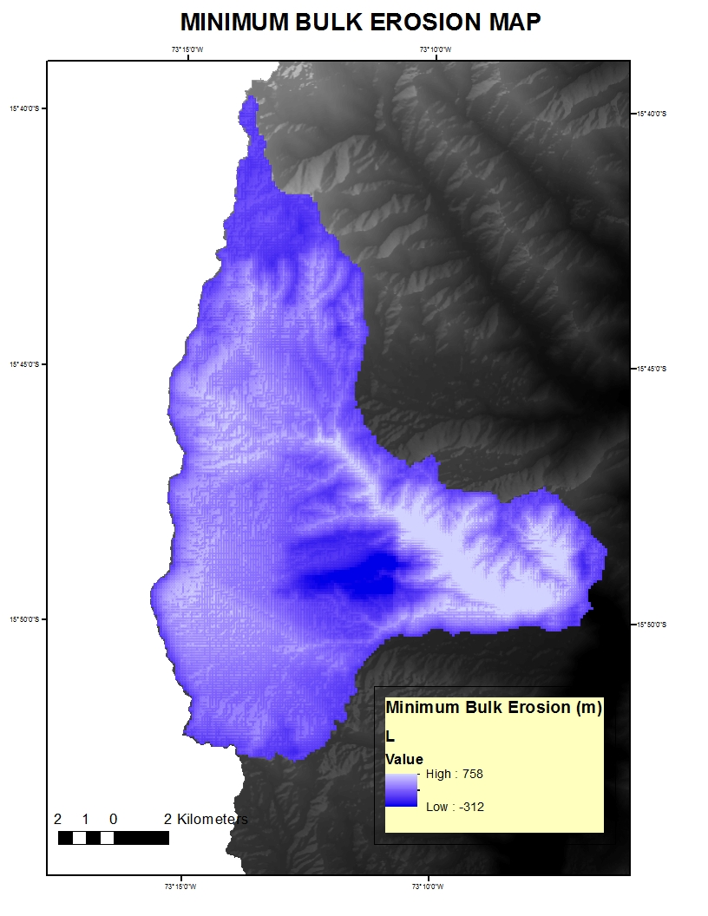
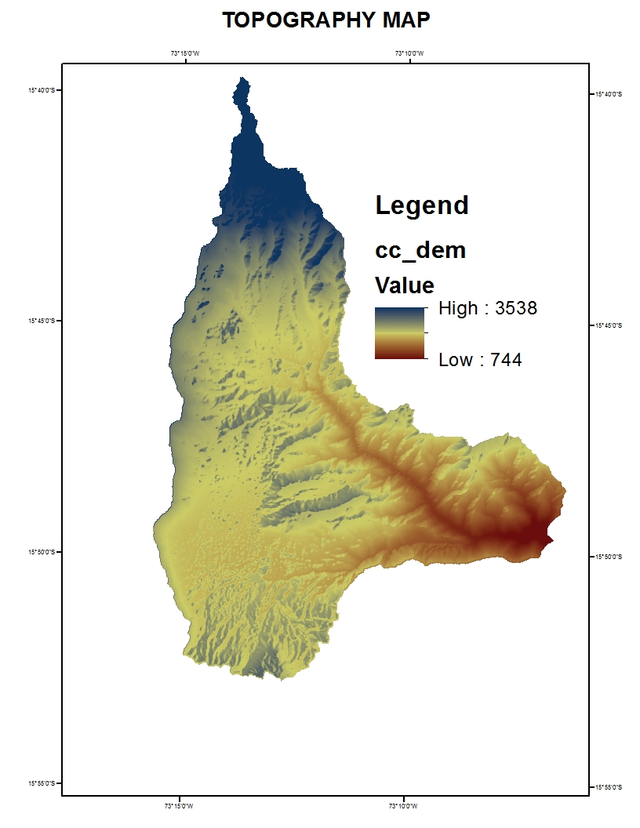
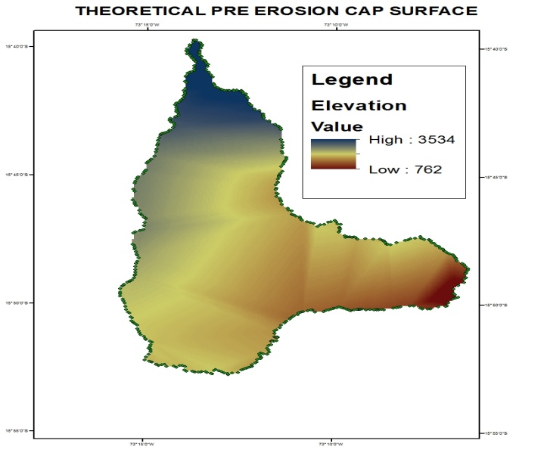
Spatial variation of Minimum Eroded Volume
Minimum eroded volume = 3.01km3

Slide 3
MINIMUM ERODED VOLUME
SUM x Area of a Single pixel = Volume in m3
SUM = 3,225,380
DEM pixel size = 30.578 X 30.578 = 935.01m2
Calculate volume –> 3,225,380 x 935.01m2= 3,015775726.25192 m3
Convert units from m3 to k m3 –> Divide m3 by 1,000,000,000 (one billion) to get km3
Minimum Eroded Volume = 3.01 km3

Slide 4
INTERPRETATION OF RESULTS IN THE LIGHT OF TECTONIC ACTIVITY
I observed that the tectonic deformation is in the horizontal direction, we obtain high value of minimum eroded volume along the major river in the watershed, this occurred due to a constant loss of sediments.

